Slide 1
Information Extraction from Biomedical Text
Nathan Srirama, Zherui Lin

Slide 2
"Everybody in America has enjoyed the benefits of biomedical research. From the creation of new vaccines, drugs, or procedures to treat or prevent illnesses, to the safety testing of items we use in our day-to-day lives, biomedical researchers strive to better comprehend the causes and cure of illnesses. The similarities between laboratory animals and human beings have been crucial in biomedical research since they explain a lot about how human bodies function. The knowledge acquired from experimentation with laboratory animals has been successfully applied not only to humans but also to wildlife, pets, as well as other animals."
http://www.nhinbre.org/
Notes:
New Hampshire IDEA network for Biomedical Research Excellence

Slide 3
Introduction
"Bioinformatics research often requires a very large amount of research literature for providing reference evidence"*
Named Entity Recognition is vital to extracting meaning from biomedical texts
Protein & gene information currently must be hand-tagged by researchers for computers to understand
K.H. Chen, “Organization and Extraction for Information,” Journal of Library and Information Studies, Vol. 12, 1997, pp. 127-141.

Slide 4
Goals
Automate Recognition of Protein names from Biomedical texts through regular expression.
Create framework for identifying patterns in Protein name recognition
Analyze Protein name and sentence patterns utilizing cluster analysis methods for potential future work

Slide 5
Named Entity Recognition
Automatically identifies named entities in a text and classifies them into predefined categories.
"Mark Zuckerberg is one of the founders of Facebook, a company from the United States"
Person: Mark Zuckerberg Company: Facebook Location: United States
Often used for categorizing and creating content recommendation.
Capture the pattern of the sentence that contains protein name.

Slide 6

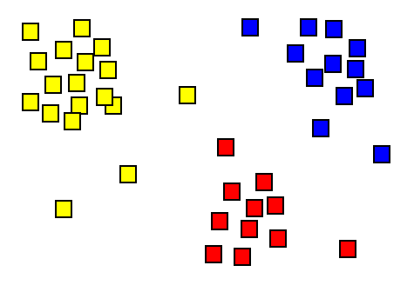
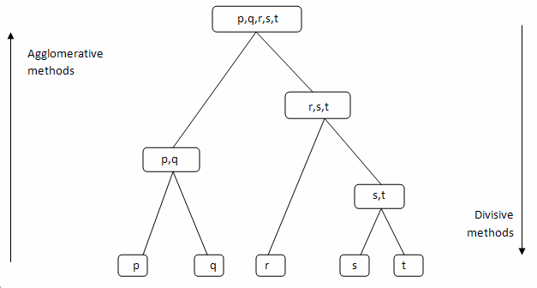
Cluster Analysis
Task involving discretization of how similar/different data points are from one another
Utilize different distance functions
Hierarchical Clustering: repeatedly creates clusters to create a hierarchy of similarities and differences
Notes:
Manhattan distance
Euclidean distance
anything

Slide 7
2 Step Process
Protein Recognition
Pattern Analysis using Hierarchical Clustering

Slide 8
Step 1: Heuristical Protein Recognition

Slide 9
Extracting Protein Names from Biological Literature Kuo, Lin
Paper detailing Named Entity Recognition methods for Protein names from widely used corpuses
Combined previous methods into new heuristic recognition process
Probability-based
Rule-based
Dictionary-based
Specific implementation largely obfuscated, but provided frameworks
ACSIJ Advances in Computer Science: an International Journal, Vol. 3, Issue 2, No.8 , March 2014 ISSN : 2322-5157 www.ACSIJ.or

Slide 10
Uniprot Database
Comprehensive Protein/Gene sequence Data Repository
Databases
Datasets
Reference Clusters
Knowledgebases
Labels annotated & reviewed entries
This research utilized a reviewed data on protein names associated with Homo Sapiens
Notes:
Universal Protein Resource
Internationally backed & funded
Not all hand made, but ones that are are labelled as such
- handmade are all reviewed by multiple parties to ensure accuracy

Slide 11
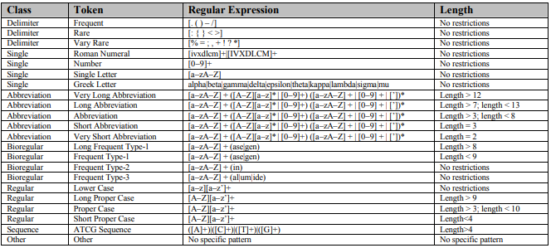
General Rules for Regular Expression

Slide 12
Seven categories of Regular Expression
1. Delimiter : Words that contains special symbols.
For Example : - () : %
2. Single: Words that contains digital or single character.
For Example : V,XI,1,a,alpha
3.Abbreviation: Words that represent abbreviation of protein names.
For Example : KKLSMYGVDLHKAKDL,CD23
4.BioRegular: Words that represent word suffixed.
For Example: ase,gen,in,al,um,ide

Slide 13
Seven categories of Regular Expression
5.Regular: Wide range of protein name or non-protein name
For Example:Uppercase,lowercase
6.Sequence: Words that represent DNA sequences
For Example: AAGCTTGGGT
7.Other: Any other words

Slide 14
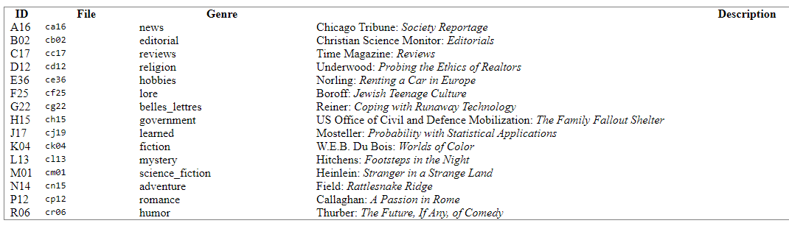
Potential Problem and solution
Dataset
3630 words, 130 sentences.
Repeat words
Fixed through list(set) function
Reduce from 1220 words to 987 words
Unrelated words
Runing against Brown corpus.
Reduce from 987 words to 275 words

Slide 15
Match the Protein names with database
Diversified
Example :TBC1 domain family member 9B, Talin-1
Two Approaches
1. Limit the length of the protein name, only match the proteins with less than two words
Issue: We are decreasing the possibility for a match
2.Match the protein name regardless of the length of the name.
Issue: We are increasing the possibility for a match

Slide 16
Results
"TNF"
TLR stimulation of cord blood leukocytes results in a lower production of proinflammatory, Th1-associated cytokines (IL-12p70, TNF-α, IFN-α)
'III"
It is in close communication with AM and acts an immune sentinel producing inflammatory mediators, such as type I and III interferons, mucus, and antimicrobial proteins (45, 83)
"inflammatory"
The mechanisms that regulate inflammatory responses to microbial stimulation in the lung need to be more fully elucidated

Slide 17
Step 2: Analyzing Patterns in Textual Protein Usage

Slide 18
Data Format
Obtained list of sentences that were identified as containing Protein names
Identified parts of speech (POS) for all words
Condense POS into single string where each character corresponds to a POS group

Slide 19
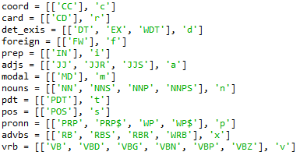
Word Tagging & Sentence Condensing
31 POS tags as defined by nltk.pos_tag function
Grouped similar tags to create 13 distinct groups for protein sentence analysis
For each word in a sentence, replace with character corresponding to its POS group

Slide 20
Sentence Condensing Example
Input Sentence: "This is a test made by Lin's students to showcase group tagging"
Nltk Tagged: [('This', 'DT'), ('is', 'VBZ'), ('a', 'DT'), ('test', 'NN'), ('made', 'VBN'), ('by', 'IN'), ('Lin', 'NNP'), ("'s", 'POS'), ('students', 'NNS'), ('to', 'TO'), ('showcase', 'VB'), ('group', 'NN'), ('tagging', 'VBG')]
Group Tagging: "dvdnvinsnvnv"

Slide 21
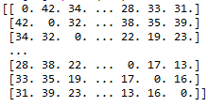
Utilizing Levenshtein Edit Distance
Clustering must be done on numeric data
Create a matrix of the edit distance between all Condensed sentences
This matrix defines our hierarchical clusters, just have to visualize using a particular cluster method

Slide 22
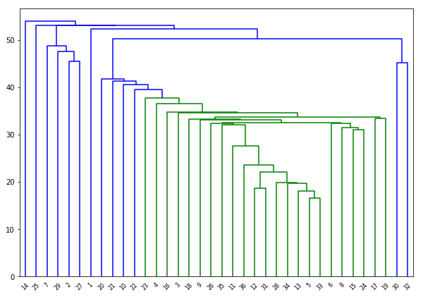
Results
2: 'nninnvnidaninannnncanincdancnxvninnnianvrnnnrrr'
27: 'idannnidnnnnidaanincaninnvidnnxinnnaannvvrr'
13: 'anmviandncvn'
33: 'nvdxanidaninn'
34: 'idnnpvancnvnn'

Slide 23

Questions?

